Slide 1
Trusted Digital Web and the Decentralized (DID) OSI Model 0.9 – January 15, 2022
Enterprise Architecture Domains
Extended OSI Model
Trusted Digital Web
Decentralized (DID) OSI Model
Business Domain/Architecture
8. Business
did:bluetoqueproc
Decentralized (DID) Processes
Application
Domain/Architecture
7. Application
did:bluetoqueagent
Decentralized (DID) Agents
6. Presentation
did:object, did:color, did:bluetoquedoc, …
Decentralized (DID) Objects
Technology/Infrastructure
Domain/Architecture
5. Session
Trinity Graph Storage / VDR
Decentralized (DID) Storage
4. Transport
TCP & UDP Protocols
Segments
3. Network
IP (Logical Addressing)
Packets
2. Data Link
Physical Addressing (MAC)
Frames
1. Physical
Binary Transmission
Data Bits

Slide 2
Trusted Digital Web (TDW2022) Information Scopes (based on Social Evolution Model) – 2202-01-23
Unit | Dwelling | Characteristic Information Scope
1. Wanderer, Individual, Contributor | Tent | Personal Thoughts & Memories, Maps, Sketches
2. Party of Explorers, Group, Team | Camp | Oral History, Water Cooler Conversations
3. Family Unit, Clan, Department | Homestead | Family History, Household Knowledge
4. Band, Community, Division | Village | Communal Knowledge, Collective Knowledge
5. Tribe, Society, Company | Territory | Tribal Knowledge, Institutional Knowledge
6. Nation State, Country, Conglomerate | Nation | Common Knowledge
7. Global Co-operative of Nations (GCN) | Global | All Global Knowledge across All Languages and Repositories

Slide 3
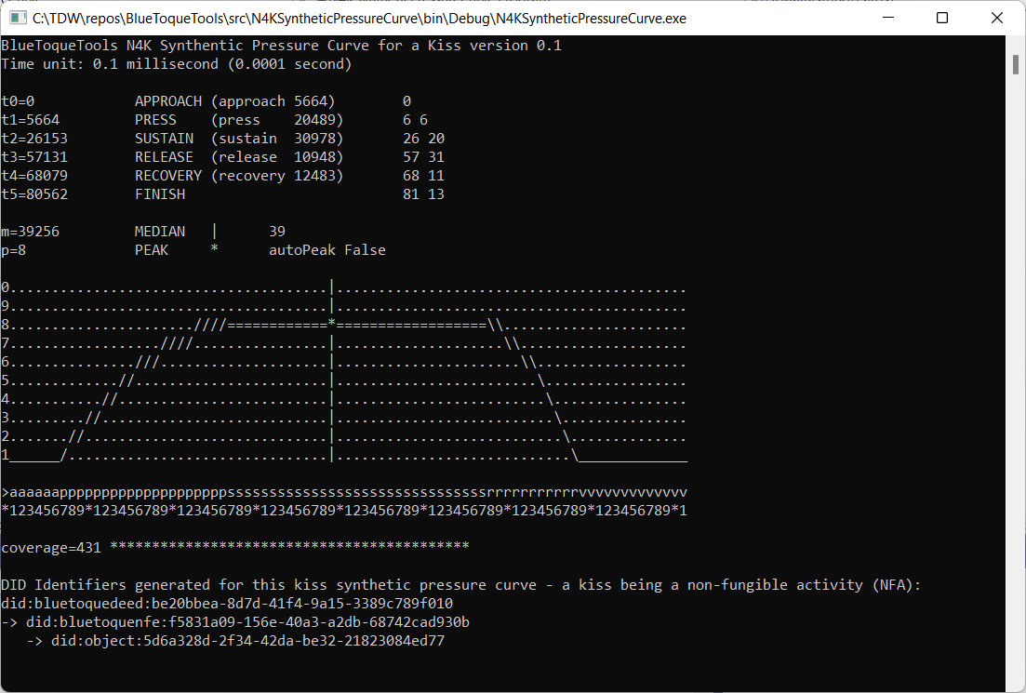
New (4th) DID-Identifiable Entity Class: Activity
In addition to People, Organizations, and Things, there is a new 4th class of DID entity
…and, as a result, potentially other new classes of DID entities waiting to be discovered
4th new class: Activity (Non-Fungible Activity)
An Activity is different from a Thing
An Activity is a self-contained (usually historical) sequence (or time-series) of measurable, closely correlatable but distinct steps
Beginning, middle, and finish steps
Examples
Kiss’s 6 steps: Approach, Press, Sustain, Release, Recovery, and Finish
Car Crash, Hug, 5-course Dinner, a Belch, an Infection, a Surgery, Throw of a Bowling Ball, Baseball Pitch, Kicking a Field Goal in Football, …
Non-examples
Criminal investigation, Daily stock ticker (e.g. NASDAQ:MSFT), Seismic trace, …

Slide 4
New (5th) DID-Identifiable Entity Class: Marketplace
In addition to People, Organizations, Things, and Activities, there is a new 5th class of DID entity
…and, as a result, potentially other new classes of DID entities waiting to be discovered
5th new class: Marketplace
A Marketplace is different from an Organization and a Thing
A Marketplace is a (digital) Service where:
Assets are offered for sale by an Offering Party, bid upon, purchased by, and delivered to an Acquiring Party.
Assets are offered in exchange for other Assets between two or more Offering Parties.
Deeds (Marketplace Policies) are negotiated and/or accepted for the conveyance of Title (a set of rights) to the Asset from the Offering Party to the Acquiring Party.
Business documents (e.g. purchase orders, invoices, waybills, and delivery confirmations, etc.) can also exchanged and reconciled through a Marketplace when it is easier to use a Marketplace than it is to engage in direct two-party (or multi-party) exchanges and reconciliations.
Examples
NFE (NFT) marketplaces, international trading centers involving Letters of Credit (and/or similar instruments), international and regional freight shipping networks, marketplaces for other products and service offerings, …

